Slide 1
Slay the Spire
Recurrent Win Prediction
Joseph Russoniello and Fernando Martin
Notes:
Hello I’m Joseph Russoniello, and I’m Fernando Martin and our research was on win prediction for the video game slay the spire

Slide 2

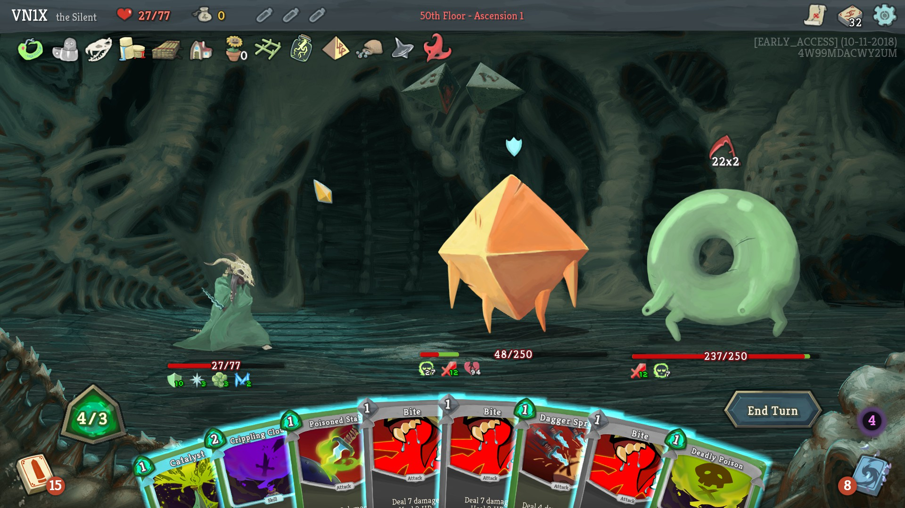

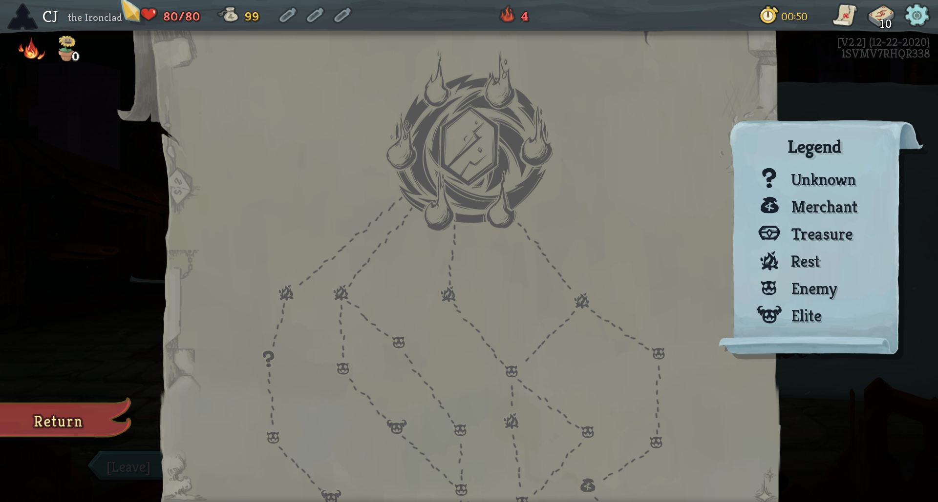
Gameplay Loop
Existing Research
Choose Path
Collect Cards
Fight Battles
Notes:
Slay the spire is a rouge-like deckbuilder where you collect cards, choose a path, and fight battles. Several people have used tried to use ML/AI for this game, but previous research is either focused on…

Slide 3
Gameplay Loop
Existing Research
Our Model
Choose Path
Collect Cards
Fight Battles
Notes:
Search-based algorithms that try to solve individual fights, or…

Slide 4
Gameplay Loop
Existing Research
Our Model
Choose Path
Collect Cards
Fight Battles
Notes:
Used overly informative features to predict whether a run win or lost given its end state

Slide 5
Existing Research
Our Model
Choose Path
Collect Cards
Fight Battles
Notes:
Our research is instead focused on the bigger decisions that shape a run

Slide 6
Problem Statement
Assess Run Strength (Win Probability) at EACH STATE
Notes:
Specifically, we aimed to assess a given run’s strength (win probability) at each state

Slide 7
CHALLENGES
DATA | No dataset except run files (event- based JSON)
DECK STATE | 1300 possible cards, up to 50 cards in a deck, up to 65k Dimensions per record
HIGH VARIANCE | Neural network output predictions “jitter” too much between timesteps
ASSESSING MODEL QUALITY | 80% of runs lose. Ideal model should gradually build confidence, and lose it when a player “chokes”
Notes:
We faced several challenges in development.
First, the best available dataset was a JSON log of events for a run, not a floor level table.
We also had to deal with the complexity of deck state with 1300 possible cards and up to 50 cards in a deck.
Our main problems were in fighting high variance, or unstable outputs for similar inputs in our NNs
And most difficult was in assessing model quality: an average of 80% of runs lose, so an ideal model should gradually build a sense of confidence, and lose that confidence when a mistake is made

Slide 8
Data Processing – Encoding The Deck
01
02
03
126k Runs
3M Floors
Encode Deck
Published by a Slay the Spire Developer on Reddit!
Each with a running deck state array
Count occurences of each card. Then reduce dimensionality
Notes:
In Slay the Spire, your cards are everything, so we handled this carefully. We started with a JSON file with 126k Runs, which we processed into a 3 Million Record Dataset with one record per floor, each with a running deck state array. Then maintained a count of each card in a deck and prepared for dimensionality reduction

Slide 9
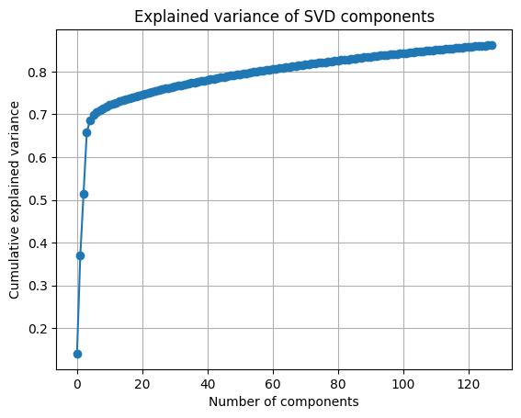
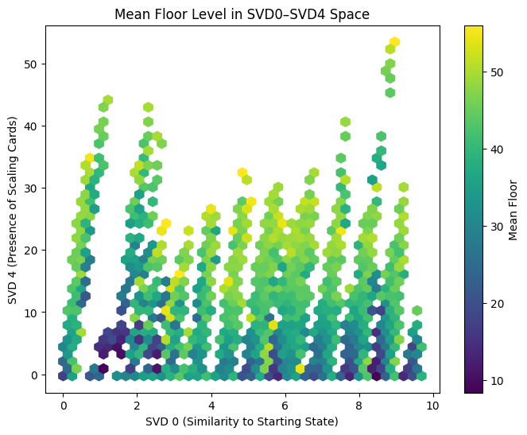
Dimensionality Reduction – Singular Value Decomposition
86% of deck variance captured in 128 Components
SVD components track how well a deck scales into the late game (SVD4 clusters run-deciding cards)
Notes:
We reduce the deck dimensions using Singular Value Decomposition. It turns out, 86% of variance between all possible slay the spire decks can be encoded in just 128 dimensions! Interestingly, some of the components track how well a deck is scaling in the late game, like SVD4 shown here

Slide 10
Models
01
02
03
04
Baseline: Majority by floor
Logistic Regression
Neural Networks / DNNs
LSTMs
(RMSProp)
Notes:
For our models, we compare to a baseline of picking the majority class by floor. We trained, a logistic regression, Neural Networks, and LSTMs with an RMSProp optimizer

Slide 11
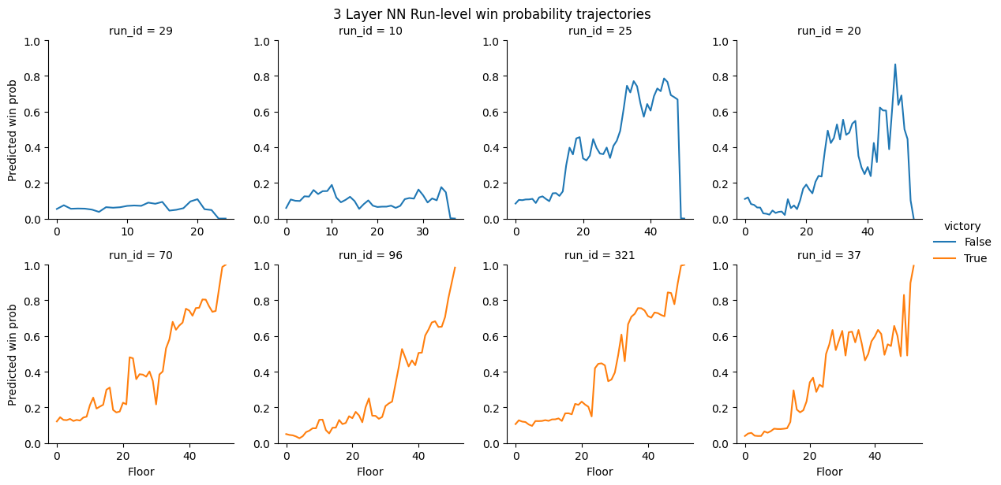
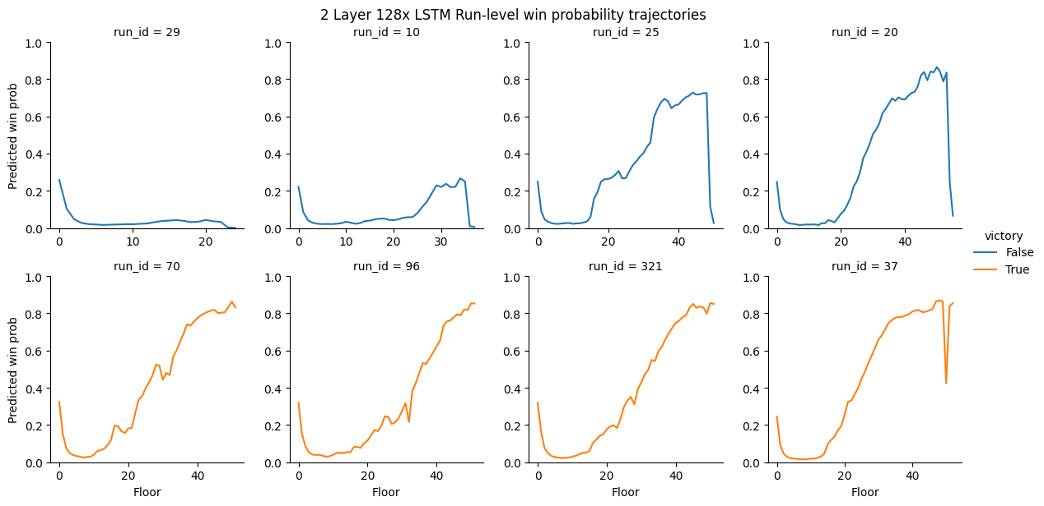
Model Comparison
Can determine when a run “chokes”, but is too volatiles
High recall throughout run, confident earlier, smooth predictions. Still finds “choke” points.
Notes:
Our models perform exceptionally well! The 3-Layer Neural network was able to get a sense of “winning” and “choking” a run, but is too volatile, while the LSTM based architecture is much more stable, carrying state information forward. However, these results seem approximately linear, which begs the question

Slide 12
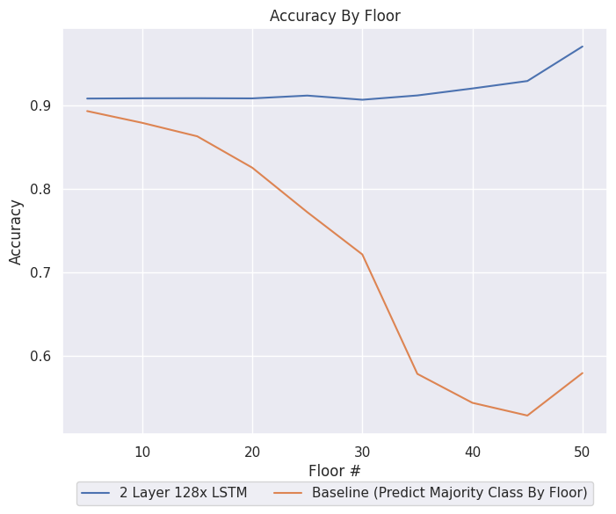
Are We Leaking?
Notes:
Are we leaking to much information by including the floor count? To answer this, we can compare to the baseline model of majority class by floor, and see that our models are far more accurate, especially as the run progresses!

Slide 13
Conclusion
The LSTM Architecture (with and without attention) drastically helped stabilize predictions between two similar states, and dramatically increased recall
Notes:
In conclusion The LSTM Architecture (with and without attention) drastically helped stabilize predictions between two similar states, and dramatically increased recall

Slide 14
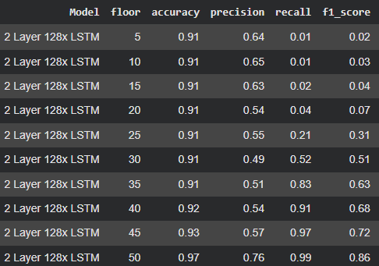
Our Results and Potential Next Steps
Stacking Algorithm: Architecture effectiveness varies by floor
Reinforcement Learning: Use win prediction as a state policy for Big Picture Decision Makers
Create an “Eval Bar” Mod in-game
Notes:
Our LSTM model is exceptionally strong, with 91% recall 10 floors before the final boss, and 99% recall right before the final boss.
If we were to continue this project, we would consider using a stacking architecture, using our predictions to inform reinforcement learning, or creating an “Eval Bar” mod in game

Slide 15
THANKS!

